Slide 1
CLOUD COMPUTING

Slide 2
Cloud Introduction
-WHAT
-WHY
Cloud Computing Architecture
Types of Cloud
Cloud Service Models
Cloud Service Providers

Slide 3
WHAT
WHY
MODELS

Slide 4
WHAT
Stores
Process data on internet
Manage

Slide 5
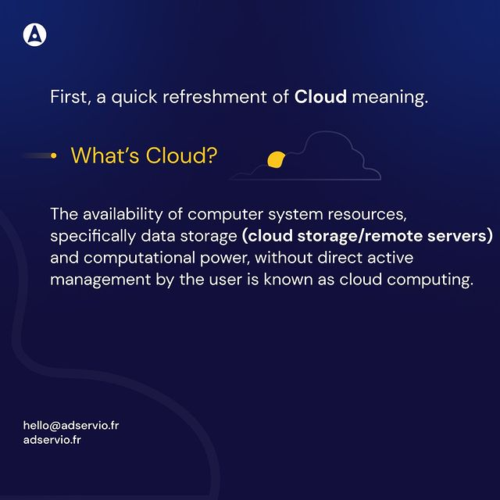

Slide 6
WHY?
Html,css -> website
We Wanna launch na
Need server, (lots of lakhs)
Manage traffic ,(at a time, lot of people check in )
monitor/maintain
Security
Above all, handled by cloud computing

Slide 7
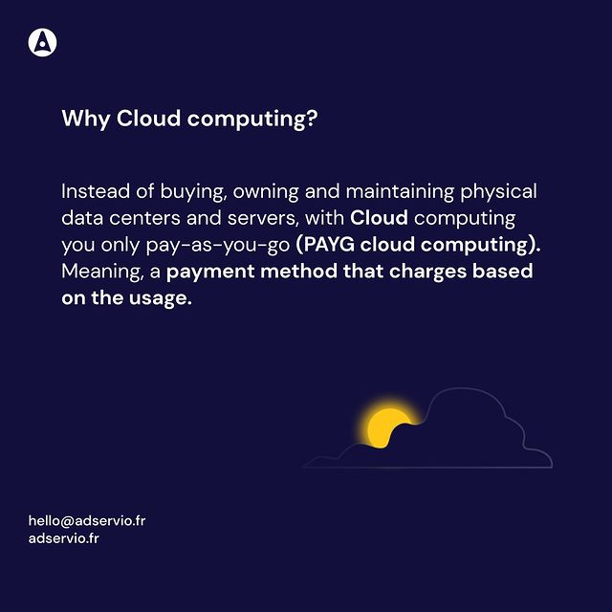

Slide 8
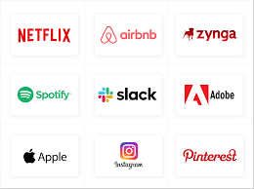
COMPANIES USING CLOUD

Slide 9
model
Service cloud computing
Deployment cloud computing

Slide 10
Deployment cloud computing

Slide 11
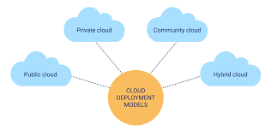
Deployment cloud computing

Slide 12
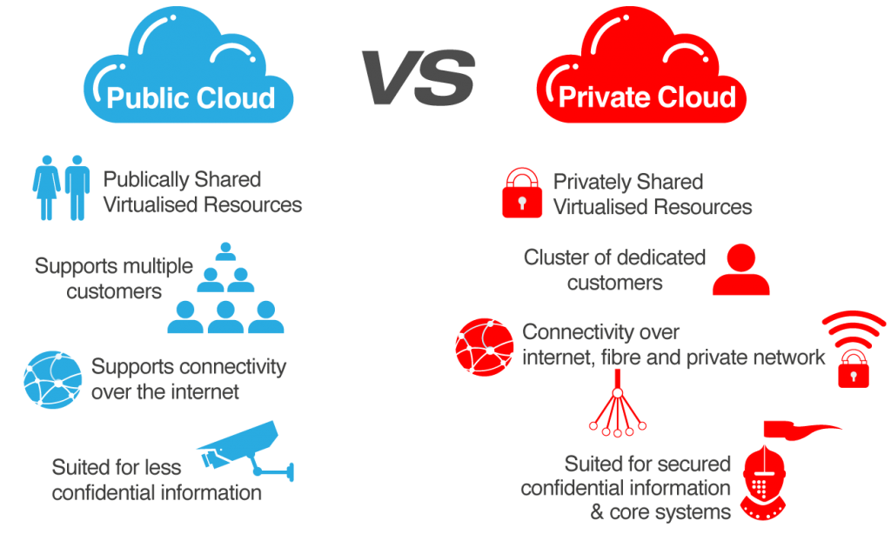

Slide 13
PUBLIC CLOUD
Public Cloud defined as a computing services offered by third party providers over the public internet, making them available to anyone who wants to use or purchase them

Slide 14
PRIVATE CLOUD
Private Cloud refers to a model of cloud computing where IT services are provisioned over private IT infrastructure for the dedicated use of a single organization.

Slide 15
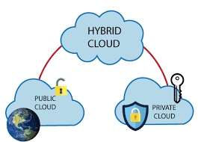

Slide 16
HYBRID CLOUD
Hybrid Cloud is a cloud computing environment that uses a mix of on-premise, private cloud & third party, public cloud services with orchestration between the two platform.

Slide 17
Service cloud computing

Slide 18
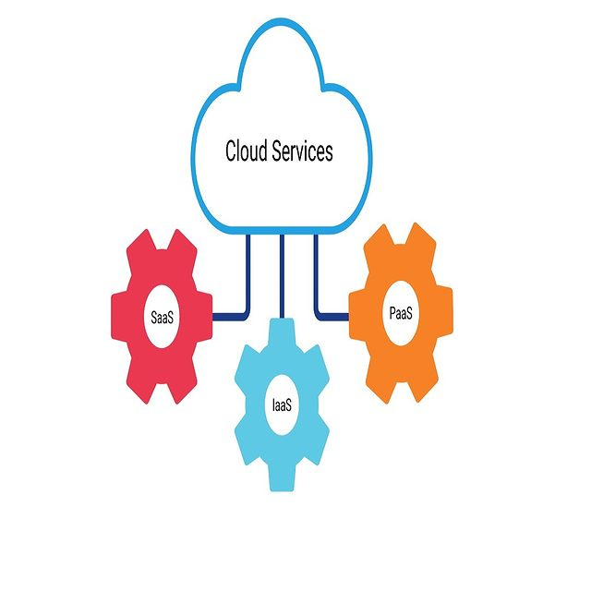
Service cloud computing
IAAS
PAAS
SAAS

Slide 19
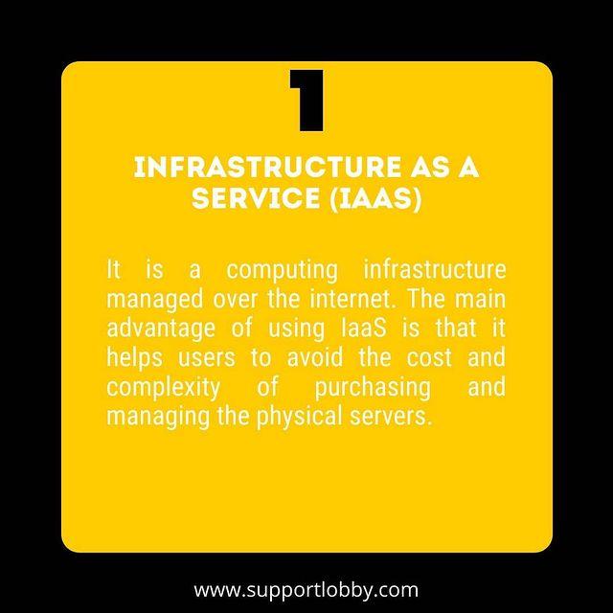

Slide 20
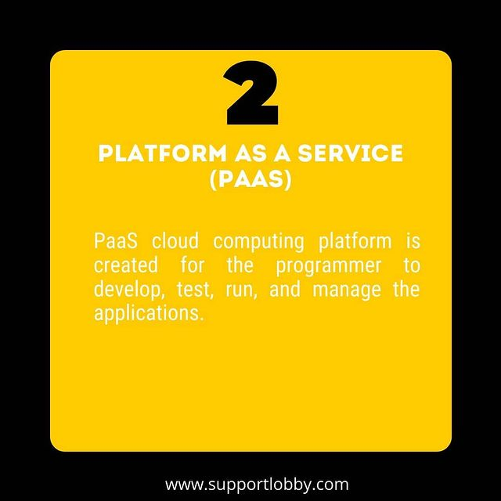

Slide 21
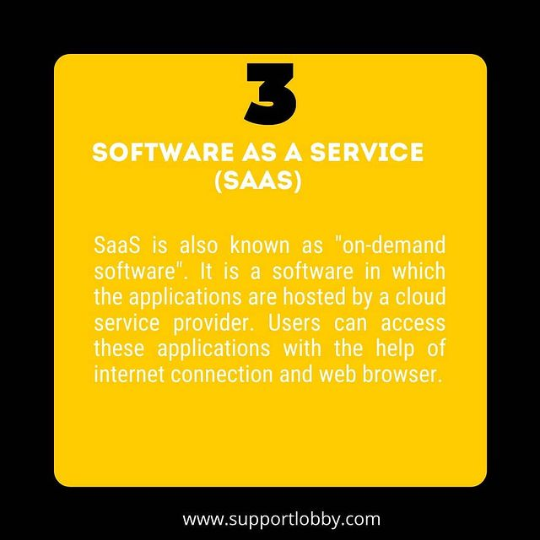

Slide 22
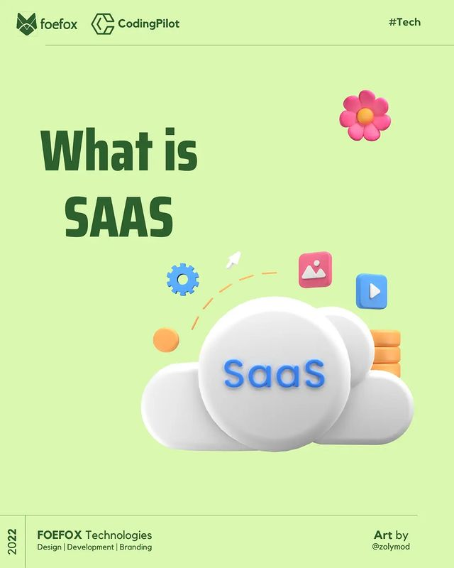

Slide 23
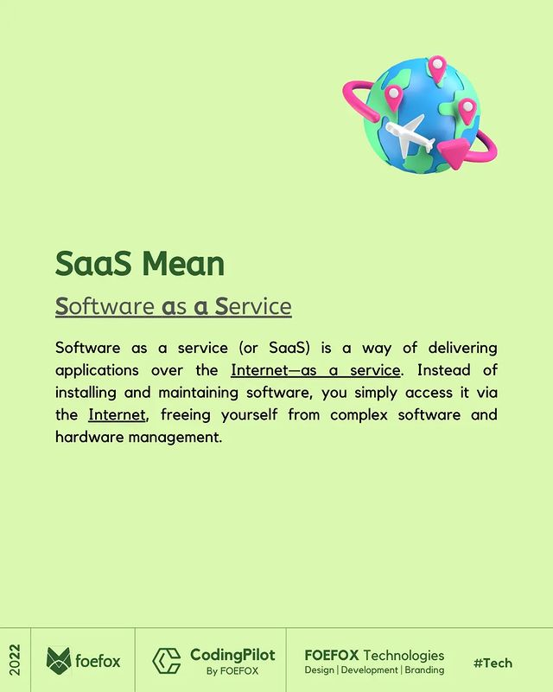

Slide 24
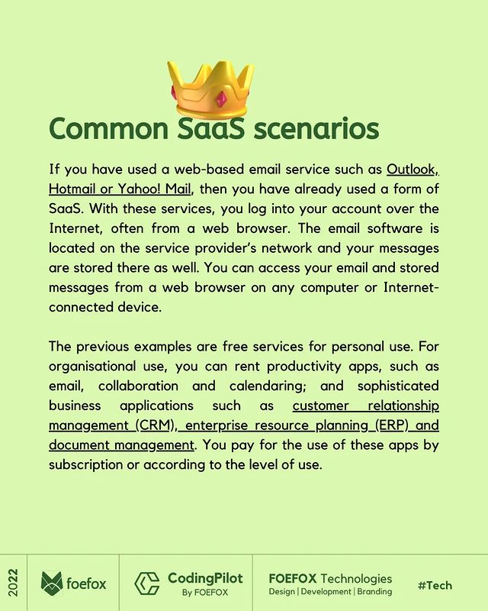

Slide 25


Slide 26
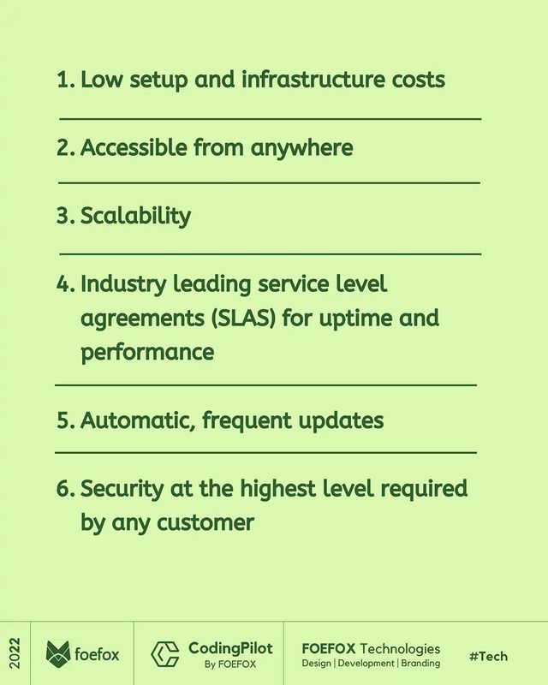

Slide 27
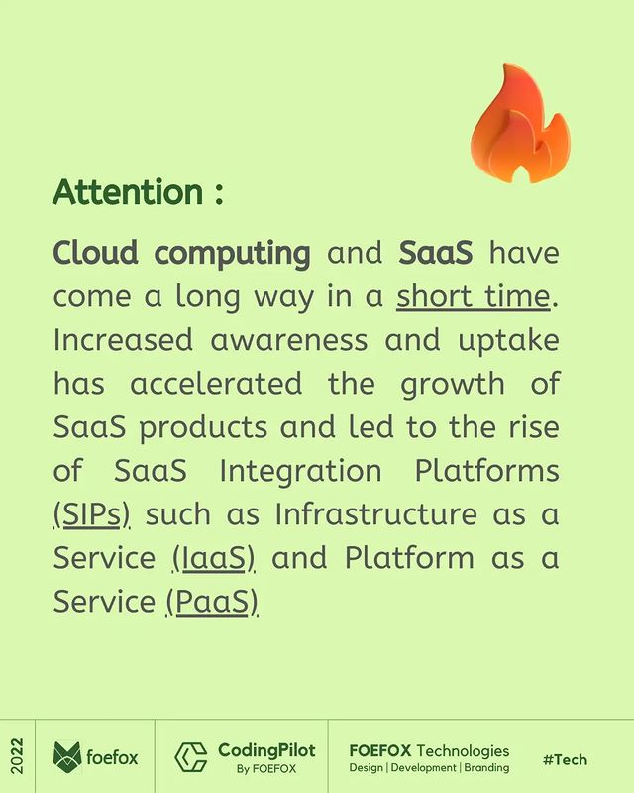

Slide 28
IAAS
Infrastructure as a Service refers to providing the complete access to the server’s OS . Typically IAAS provides hardware,storage,serversand data center or network components ; it may also include software Eg: Virtual Network

Slide 29
PAAS
In Platform as a service , one does not get access to the whole Operating System.
Rather access is given to a dashboard level, where a user uploads data,and the rest is taken care by the local provider Ex:HEROKU

Slide 30
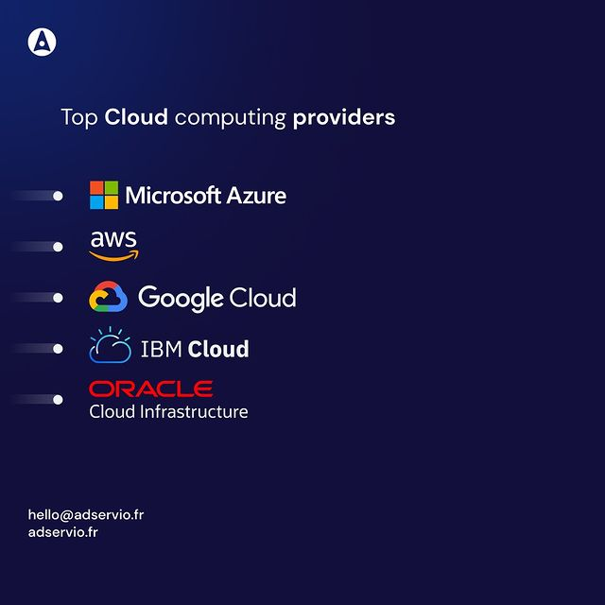

Slide 31
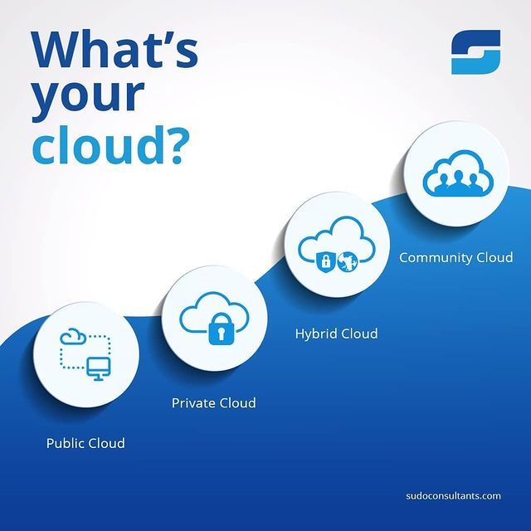

Slide 32
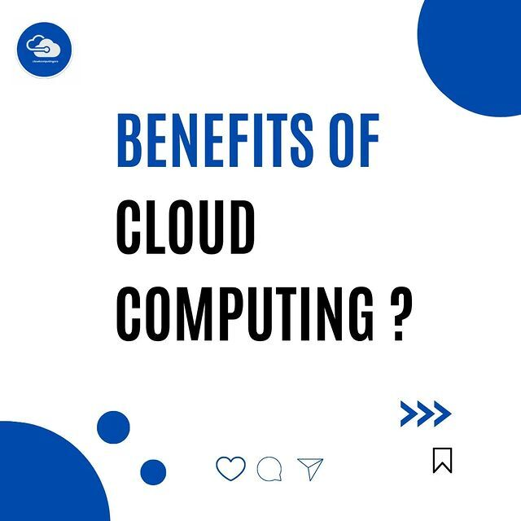

Slide 33
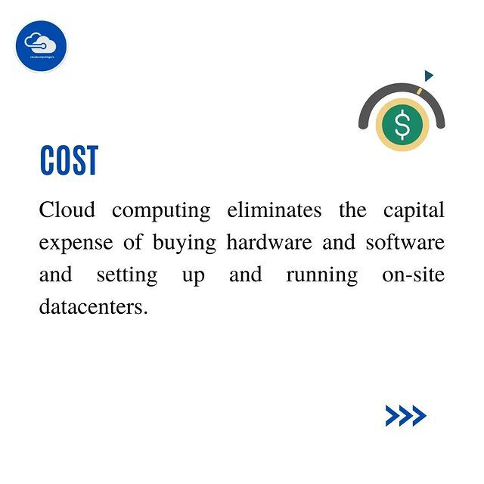

Slide 34
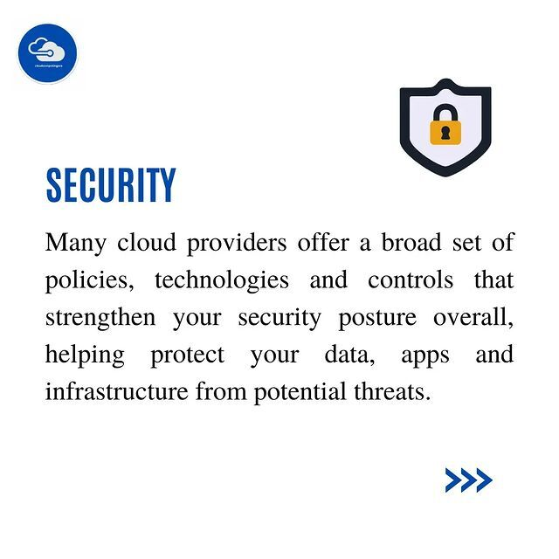

Slide 35
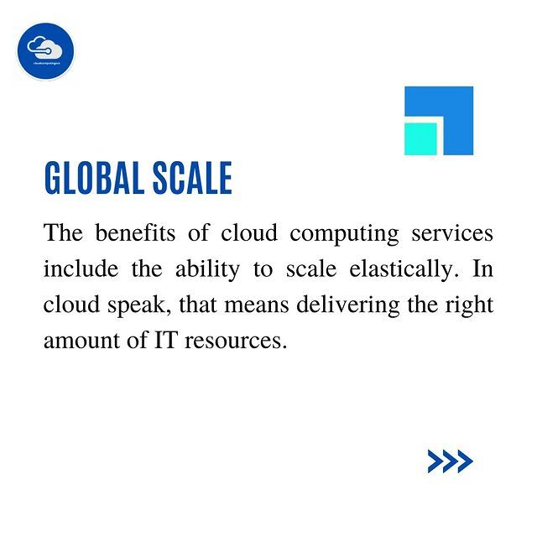

Slide 36
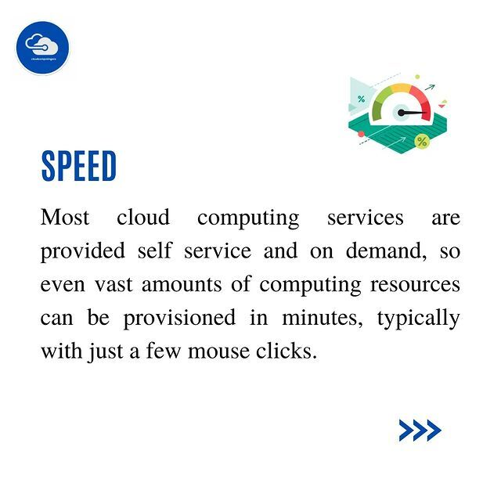

Slide 37
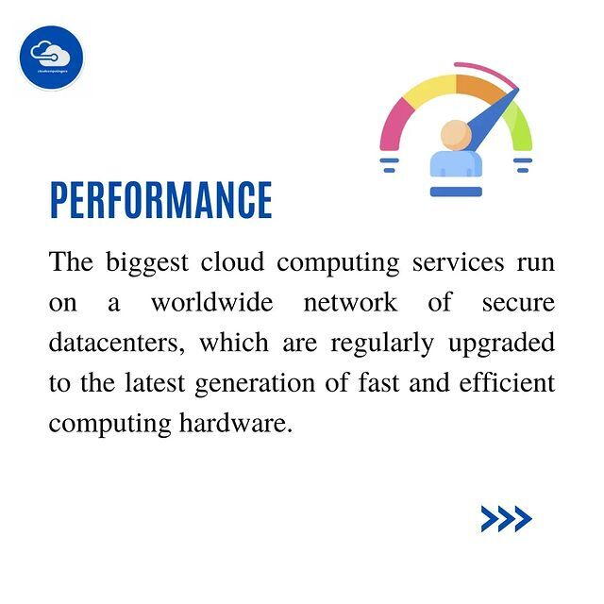

Slide 38
Cloud Computing Explained
https://www.youtube.com/watch?v=QJncFirhjPg

